Slide 1
Design Review 2
Group 17
By Eddie, Ketan, Sunny, Tim, Eric
Notes:
ed

Slide 2
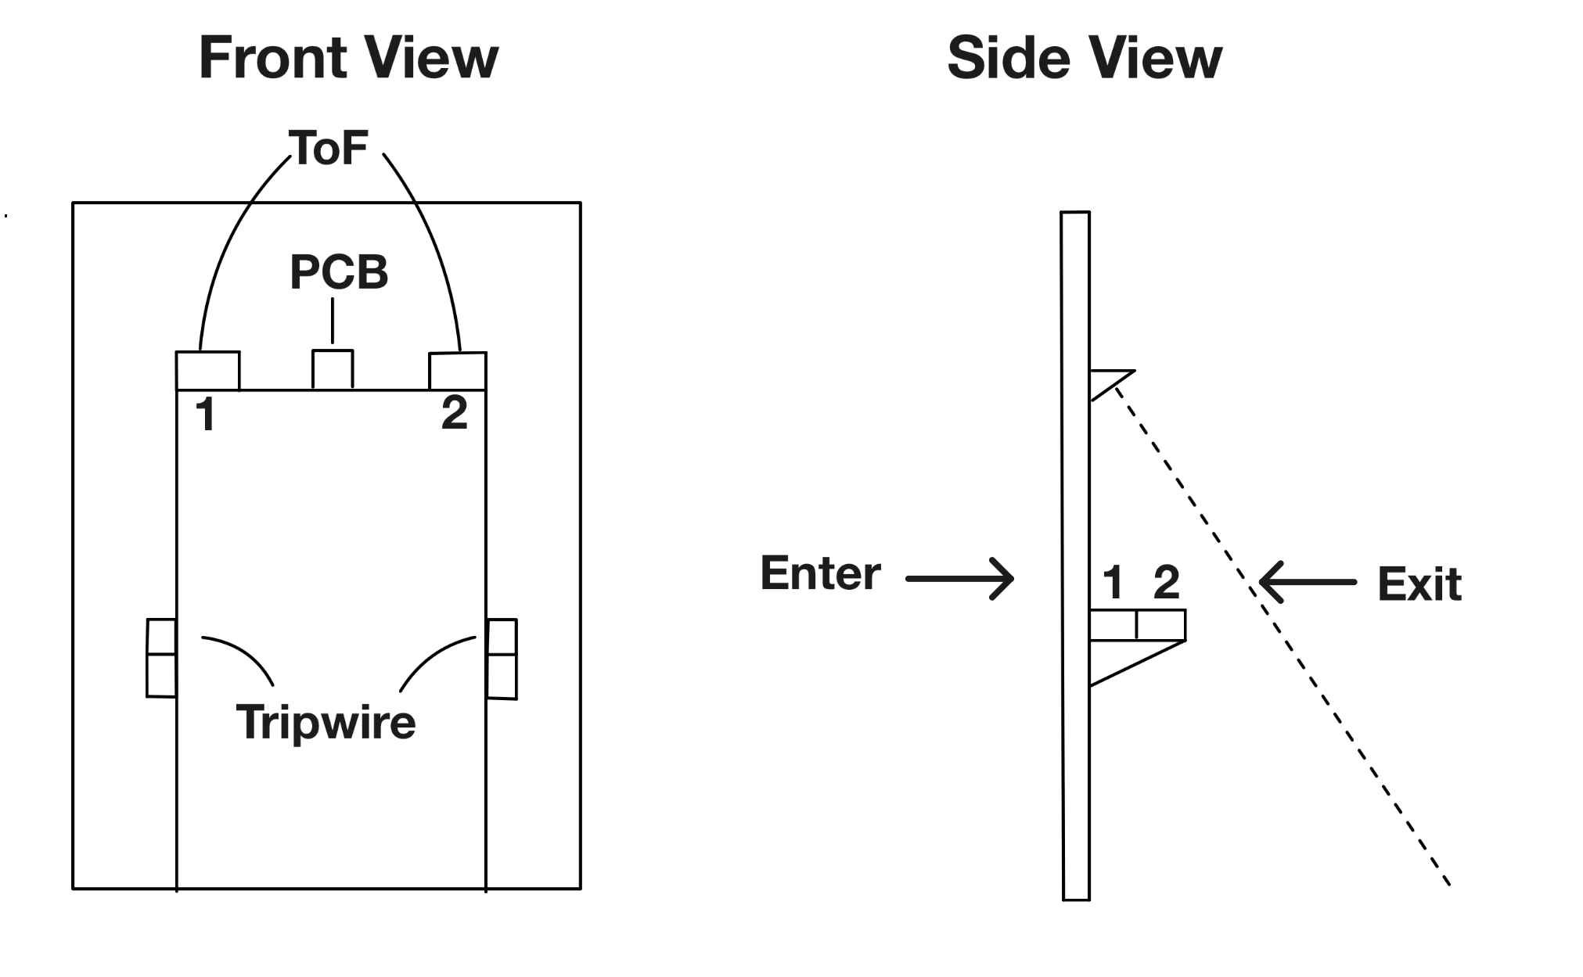
Final Design Choice
2 ToF sensors
2 Tripwire sensors
Tripwires detects base cases (MVS)
ToF handles edge cases
Better at detecting 2 different people walking through the door than thermal camera
Notes:
ed

Slide 3
Reason for Final Design
Tripwires very effective at detecting one person and person with wheelchair
Direction of people could be tracked with order of tripwires broken
Use ToF sensors on the very edge of doorway to track 2 people entering/exiting
Slanted ToF sensors to track direction of people
ToF sensors both ON operate on two person mode
Otherwise operate on one person mode
Notes:
ed

Slide 4
Quantitative Performance
Base cases: >95%
E3F tripwire accuracy >99%
Milestone 1 passed all base cases with 100% accuracy with MVS (only tripwires)
Edge cases: ~85%
Should pass 5/6 edge cases with ToF and tripwires
Person in doorway case blocks tripwires, will use ToF to track person
ToF large margin of error due to differing heights of people

Slide 5
MVS Hardware Setup
Mechanical
Two E3F tripwires mounted on the same side of the door, spaced apart
Sensors secured in a mount, mount attached using Velcro to the door
Electrical
Tripwires powered by 7.4 V LiPo battery
ESP32 powered by 5 V LiPo Battery
Tripwire outputs → voltage divider → ESP32 GPIO
Notes:
Eric

Slide 6
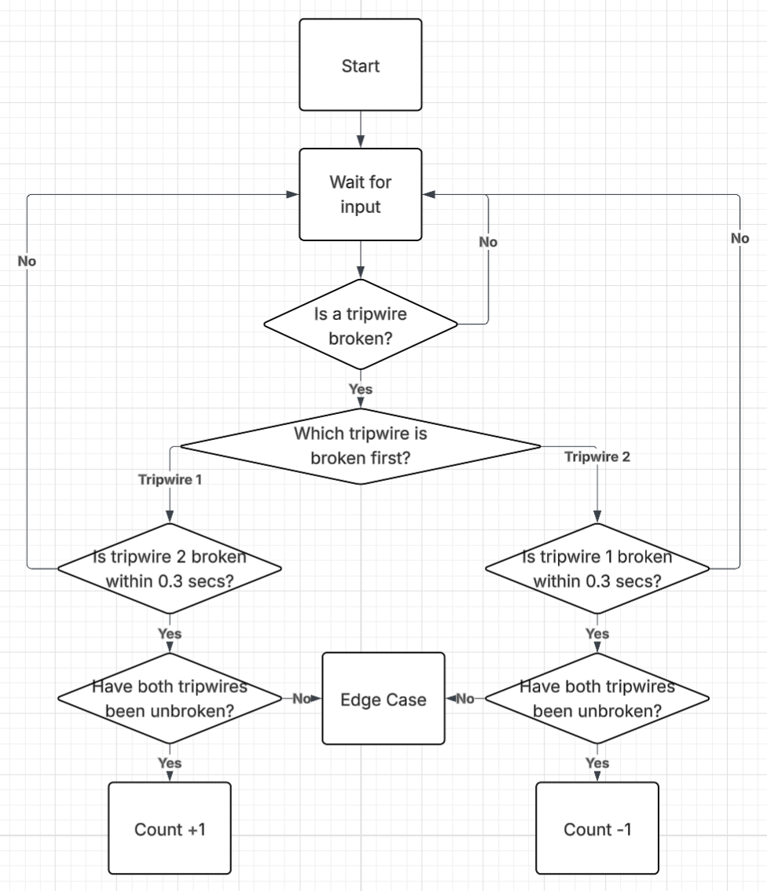
MVS Algorithm
Monitor both tripwires continuously
A sensor trigger is valid only if beam is broken then unbroken
Short delay prevents repeat triggers
Direction:
Sensor 1 → Sensor 2 → Entering
Sensor 2 → Sensor 1 → Exiting

Slide 7
MVS Cases Addressed
All Base Cases
Edge Cases:
Two people opposite directions
Walks part way in then walks out
Person in wheelchair
Person pushing person in wheelchair
Not Addressed:
Two people same direction
Person blocking doorway

Slide 8
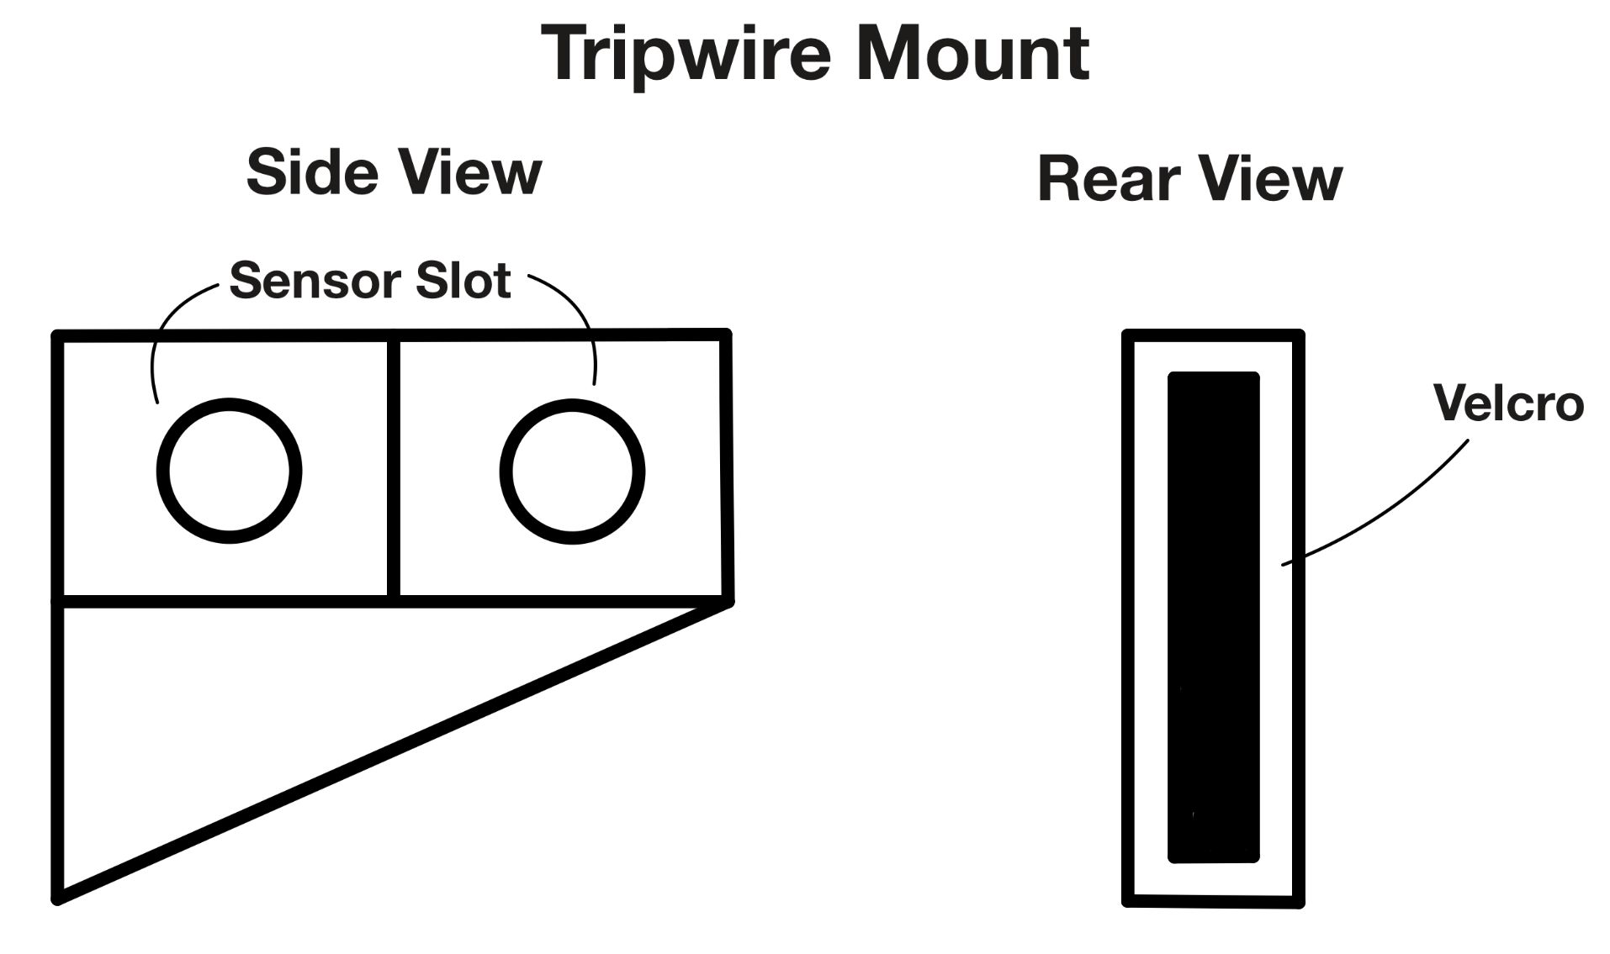
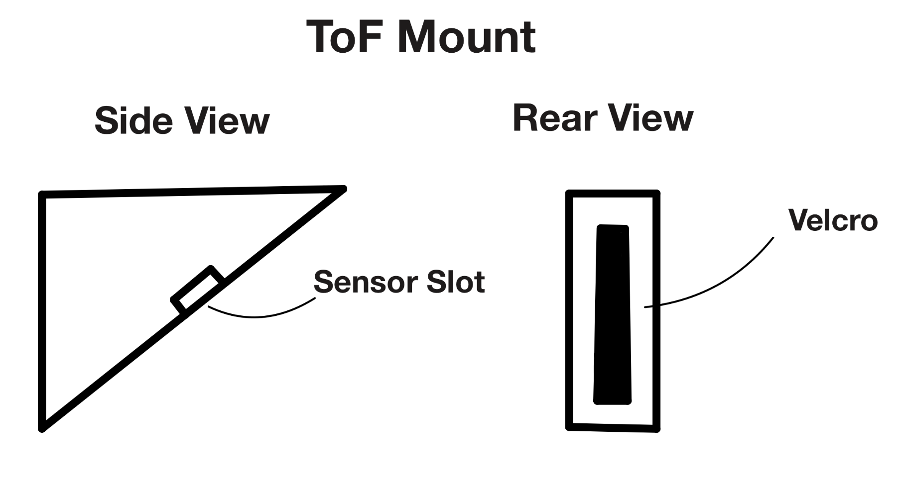
Design Specifications for Final Product
2 Tripwire sensors able to get most cases
2 ToF sensors for edge cases
Needed when 2 people walk through at the same time
Able to count what the tripwires cannot detect
Notes:
Eric

Slide 9
Final Design Hardware Setup
Mechanical
Two E3F tripwires mounted on the same side of the door, spaced apart
Two PCB1540 ToF sensors mounted on top of door frame, one on each side
Both sensors secured in mount, mount attached using Velcro to the door
Electrical
Tripwires powered by 7.4 V LiPo battery
ESP32 powered by 5 V LiPo Battery
ToF sensors powered by ESP32 3.3V
Sensor outputs connect to ESP32 GPIO and I2C pins
Notes:
Eric

Slide 10
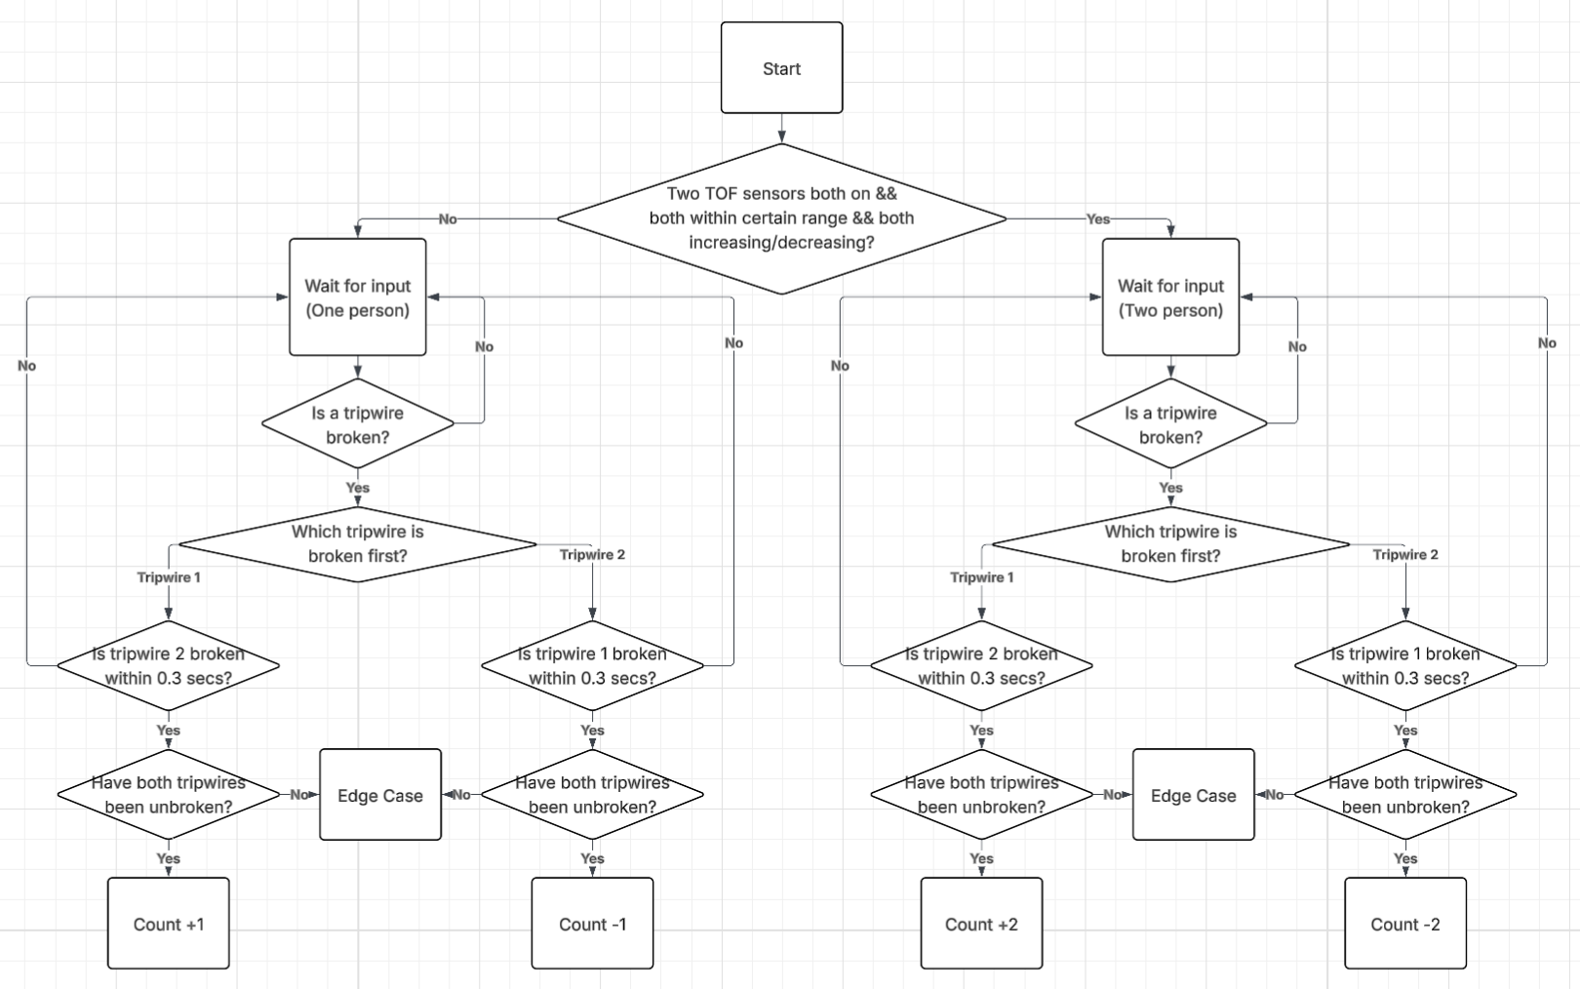
Final Design Algorithm

Slide 11
Edge Case Addressed: Two people same direction
Condition: both TOF on, distance readings both increasing/both decreasing, within certain range (dependent on doorway and person height)
If condition satisfied
Same tripwire counting system
Count +2 instead of +1

Slide 12
Edge Case Addressed: Continuously Broken Tripwires
Person standing in doorway - triggered when tripwire blocked > 1 sec
Use ToF distance readings to determine walking person
Both sensors should be on
Blocking person - distance should not change
Walking person
Distance increasing: entering, increase count
Distance decreasing: exiting, decrease count

Slide 13
Weaknesses of Design
ToF sensitivity to height & positioning
Distance readings vary with user height (children vs adults)
Can introduce error when estimating number of people
Difficulty with closely grouped people
Two people walking side-by-side or very close may be counted as one
Especially challenging if moving at similar speed
Sensor alignment and installation sensitivity
Performance depends heavily on precise mounting angle and position
Misalignment reduces accuracy significantly

Slide 14
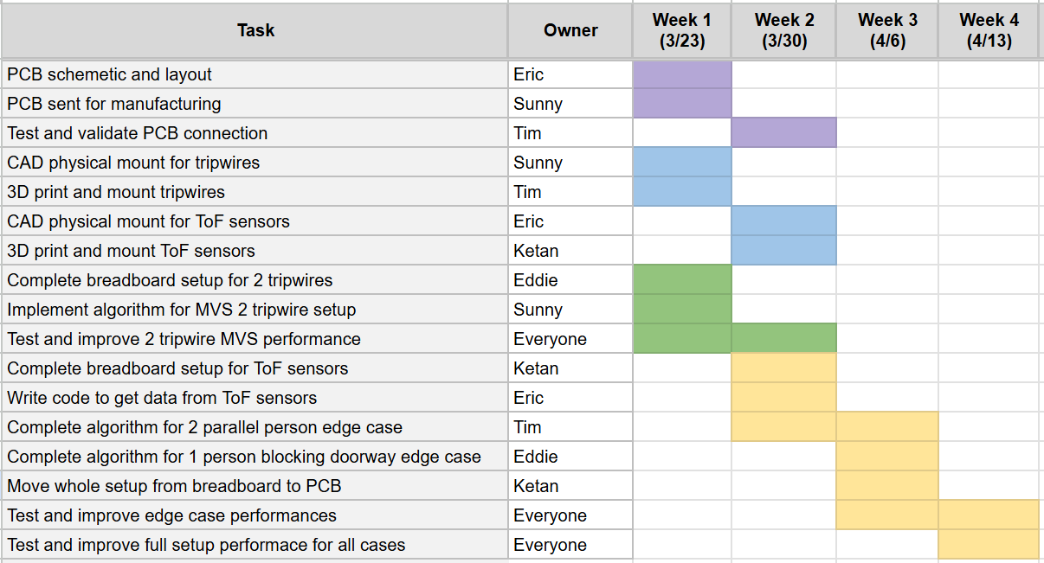
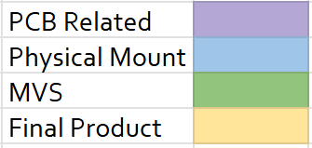
Project Schedule

